Slide 1
Cecil Ang
Sunday Service 22 Sep 2019
z

Slide 2
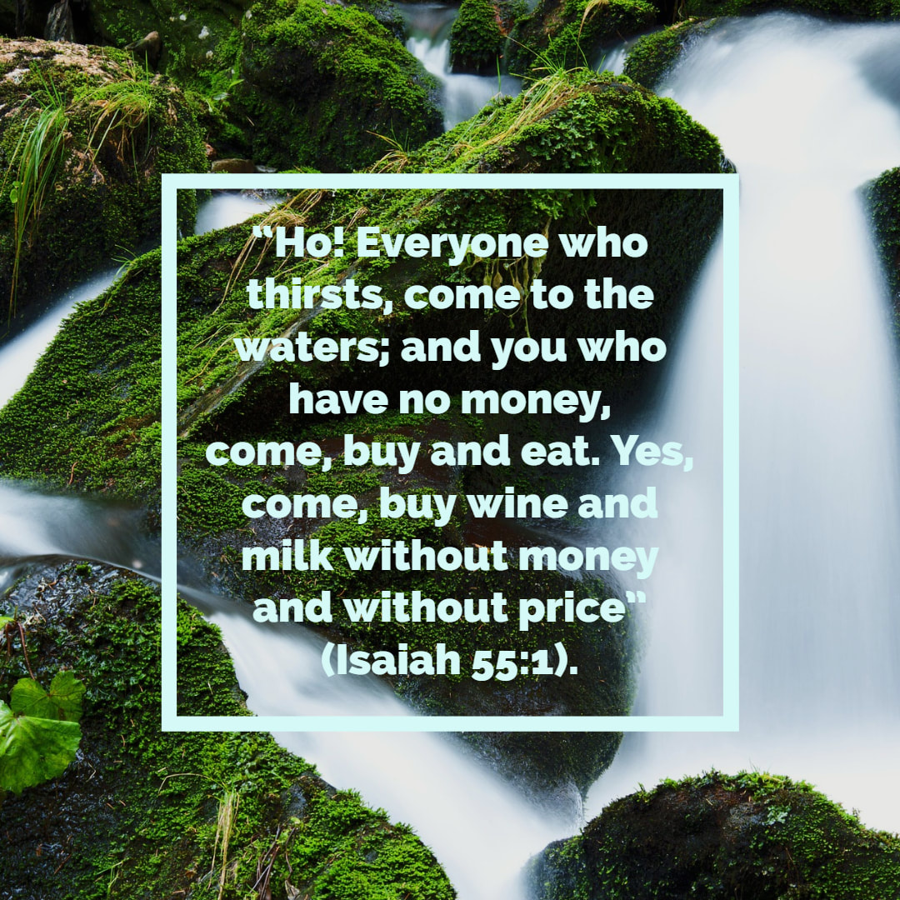
What is the GOSPEL?
God
Offering
Sinful
People
Eternal
Life

Slide 3
Acts 20:24-28 ESV
²⁴ But I do not account my life of any value nor as precious to myself, if only I may finish my course and the ministry that I received from the Lord Jesus, to testify to the gospel of the grace of God. ²⁵ And now, behold, I know that none of you among whom I have gone about proclaiming the kingdom will see my face again. ²⁶ Therefore I testify to you this day that I am innocent of the blood of all, ²⁷ for I did not shrink from declaring to you the whole counsel of God. ²⁸ Pay careful attention to yourselves and to all the flock, in which the Holy Spirit has made you overseers, to care for the church of God, which he obtained with his own blood.

Slide 4
Message Outline
Saved by the Grace of God (v 24)
Scoured by the Blood of Jesus (v 28)
Sanctified by the Power of the Holy Spirit (v 28)

Slide 5
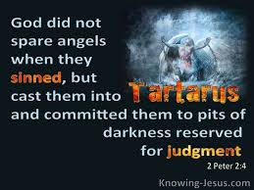
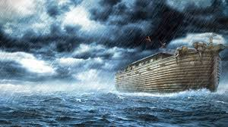
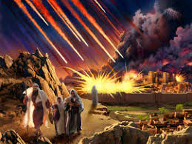
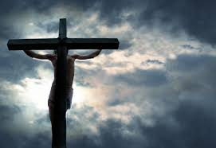
Saved by the Grace of God
The Depravity of Man
⁵ The Lord saw that the wickedness of man was great in the earth, and that every intention of the thoughts of his heart was only evil continually. ⁶ And the Lord regretted that he had made man on the earth, and it grieved him to his heart. ⁷ So the Lord said, “I will blot out man whom I have created from the face of the land, man and animals and creeping things and birds of the heavens, for I am sorry that I have made them.” Gen 6:5-7 ESV

Slide 6
Saved by the Grace of God
The Depravity of Man
All the ways of a man are clean in his own sight, but the Lord weighs the motives. Pr 16:2 NASB
We are all like an unclean thing, and all our righteousnesses are like filthy rags. Is 64:6 NKJV
“… that I may gain Christ and be found in him, not having a righteousness of my own that comes from the law, but that which comes through faith in Christ, the righteousness from God that depends on faith.” Phil 3:8-9 ESV
For all have sinned and fall short of the glory of God. Rom 3:23 ESV

Slide 7
Saved by the Grace of God
The Characteristics of God
⁶ And the Lord passed before him and proclaimed, “The Lord, the Lord God, merciful and gracious, longsuffering, and abounding in goodness and truth, ⁷ keeping mercy for thousands, forgiving iniquity and transgression and sin, by no means clearing the guilty, visiting the iniquity of the fathers upon the children and the children’s children to the third and the fourth generation.” Ex 34:6-7 NKJV

Slide 8
Saved by the Grace of God
The Characteristics of God
Mercy: something we deserve but God withholds e.g. punishment & death
Blessed be the God and Father of our Lord Jesus Christ! According to his great mercy, he has caused us to be born again to a living hope … 1 Pet 1:3 ESV
Grace: something we don’t deserve, God gives e.g. salvation & eternal life
⁸ For by grace you have been saved through faith. And this is not your own doing; it is the gift of God, ⁹ not a result of works, so that no one may boast. Eph 2:8-9 ESV

Slide 9
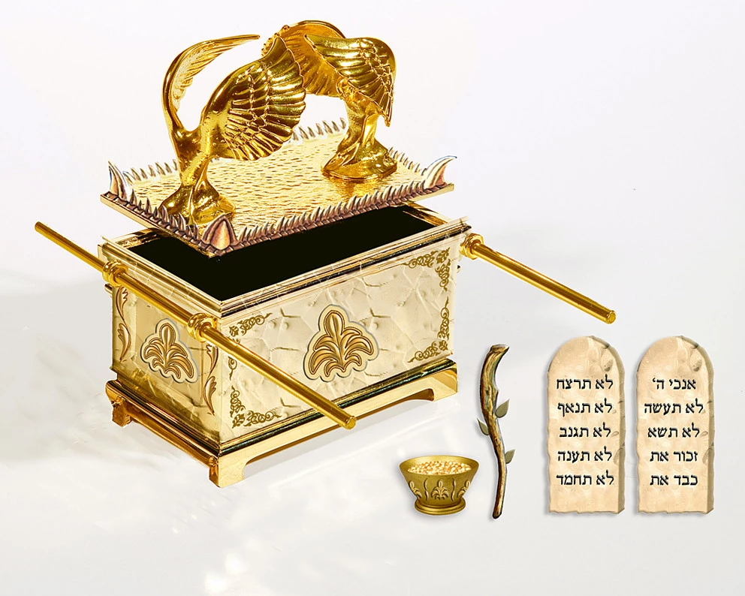
z
²¹ You shall put the mercy seat on top of the ark, and in the ark you shall put the Testimony that I will give you. ²² And there I will meet with you, and I will speak with you from above the mercy seat, from between the two cherubim which are on the ark of the Testimony, about everything which I will give you in commandment to the children of Israel. Ex 25:21-22 NKJV

Slide 10
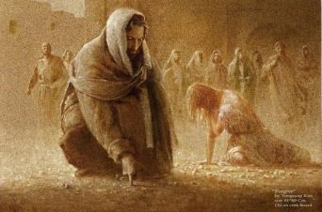
z
And the Word became
flesh and dwelt among us, and we beheld His glory, the glory as of the only begotten of the Father, full of grace and truth.
Jn 1:14 NKJV

Slide 11
Saved by the Grace of God
The Characteristics of God
²⁰ He indeed was foreordained before the foundation of the world, but was manifest in these last times for you ²¹ who through Him believe in God, who raised Him from the dead and gave Him glory, so that your faith and hope are in God. 1 Pet 1:20-21 NKJV
For our sake he made him to be sin who knew no sin, so that in him we might become the righteousness of God. 2 Cor 5:21 ESV
Let us therefore come boldly to the throne of grace, that we may obtain mercy and find grace to help in time of need. Heb 4:16 NKJV

Slide 12
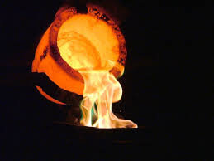
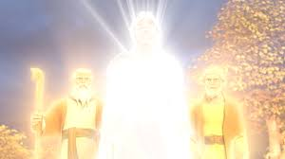
Scoured by the Blood of Jesus
Launderers’ Soap
“But who can endure the day of His coming? And who can stand when He appears? For He is like a refiner’s fire and like launderers’ soap.” Mal 3:2 NKJV
He was transfigured before them. His clothes became shining, exceedingly white, like snow, such as no launderer on earth can whiten them. Mk 9:2-3 NKJV

Slide 13
Scoured by the Blood of Jesus
The Efficacy of Christ’s Blood
For the life of the flesh is in the blood, and I have given it for you on the altar to make atonement for your souls, for it is the blood that makes atonement by the life. Lev 17:11 ESV
¹¹ But when Christ appeared as a high priest of the good things that have come, then through the greater and more perfect tent (not made with hands, that is, not of this creation) ¹² he entered once for all into the holy places, not by means of the blood of goats and calves but by means of his own blood, thus securing an eternal redemption. ²²Indeed, under the law almost everything is purified with blood, and without the shedding of blood there is no forgiveness of sins. ²⁶He has appeared once for all at the end of the ages to put away sin by the sacrifice of himself. Heb 9:11-12,22,26 ESV

Slide 14
Scoured by the Blood of Jesus
The Efficacy of Christ’s Blood
Then the temple of God was opened in heaven, and the ark of His covenant was seen in His temple. Rev 11:19 NKJV
Their sins and their lawless deeds I will remember no more. Heb 10:17 NKJV
⁷ But if we walk in the light, as he is in the light, we have fellowship with one another, and the blood of Jesus his Son cleanses us from all sin. ⁸ If we say we have no sin, we deceive ourselves, and the truth is not in us. ⁹ If we confess our sins, he is faithful and just to forgive us our sins and to cleanse us from all unrighteousness. ¹⁰ If we say we have not sinned, we make him a liar, and his word is not in us. 1 Jn 1:7-10 ESV

Slide 15
Sanctified by the Power of the Holy Spirit
But we ought always to give thanks to God for you, brothers beloved by the Lord, because God chose you as the firstfruits to be saved, through sanctification by the Spirit and belief in the truth. 2 Thess 2:13 ESV

Slide 16
Sanctified by the Power of the Holy Spirit
Sanctification is to ‘make holy’; coming from two Latin words: sanctus which means holy, and ficare which means make.
Separation from the world and being consecrated (set apart) to God
The Holy Spirit’s power enables us to overcome the sin principle in our lives in order to produce fruit in keeping with repentance & faith in Jesus Christ.
No one born of God makes a practice of sinning, for God's seed abides in him; and he cannot keep on sinning, because he has been born of God. 1 Jn 3:19 ESV

Slide 17
Sanctified by the Power of the Holy Spirit
There are 3 aspects concerning the work of sanctification:
It is work that was completed in Christ: “… we have been sanctified through the offering of the body of Jesus Christ once for all.” Heb 10:10 ESV
It is our present work of life in setting ourselves apart to God: “For this is the will of God, your sanctification: that you abstain from sexual immorality” 1 Thess 4:3 ESV
It is a future work to be performed at Christ’s return: “Now may the God of peace himself sanctify you completely, and may your whole spirit and soul and body be kept blameless at the coming of our Lord Jesus Christ.” 1 Thess 5:23 ESV

Slide 18
Differences between Justification & Sanctification
Justification | Sanctification
Counts us righteous | Makes us righteous
Pardon for sin | Power over sin
Peace with God | Peace of God
Brings eternal life | Brings victorious life
New believer in Christ | Christ in the new believer
Jn 15:5 - do nothing | Phil 4:13 - do all things
Therefore put away all filthiness and rampant wickedness and receive with meekness the implanted word, which is able to save your souls. Jas 1:21 ESV

Slide 19
Sanctified by the Power of the Holy Spirit
¹⁹ Now the works of the flesh are evident: sexual immorality, impurity, sensuality, ²⁰ idolatry, sorcery, enmity, strife, jealousy, fits of anger, rivalries, dissensions, divisions, ²¹ envy, drunkenness, orgies, and things like these. I warn you, as I warned you before, that those who do such things will not inherit the kingdom of God. ²²But the fruit of the Spirit is love, joy, peace, patience, kindness, goodness, faithfulness, ²³ gentleness, self-control; against such things there is no law. ²⁴ And those who belong to Christ Jesus have crucified the flesh with its passions and desires. Gal 5:22-24 ESV

Slide 20
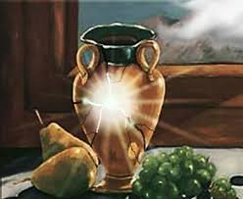
Conclusion
⁶ For God, who said, “Let light shine out of darkness,” has shone in our hearts to give the light of the knowledge of the glory of God in the face of Jesus Christ. ⁷ But we have this treasure in jars of clay, to show that the surpassing power belongs to God and not to us. 2 Cor 4:6-7 ESV

